Slide 1
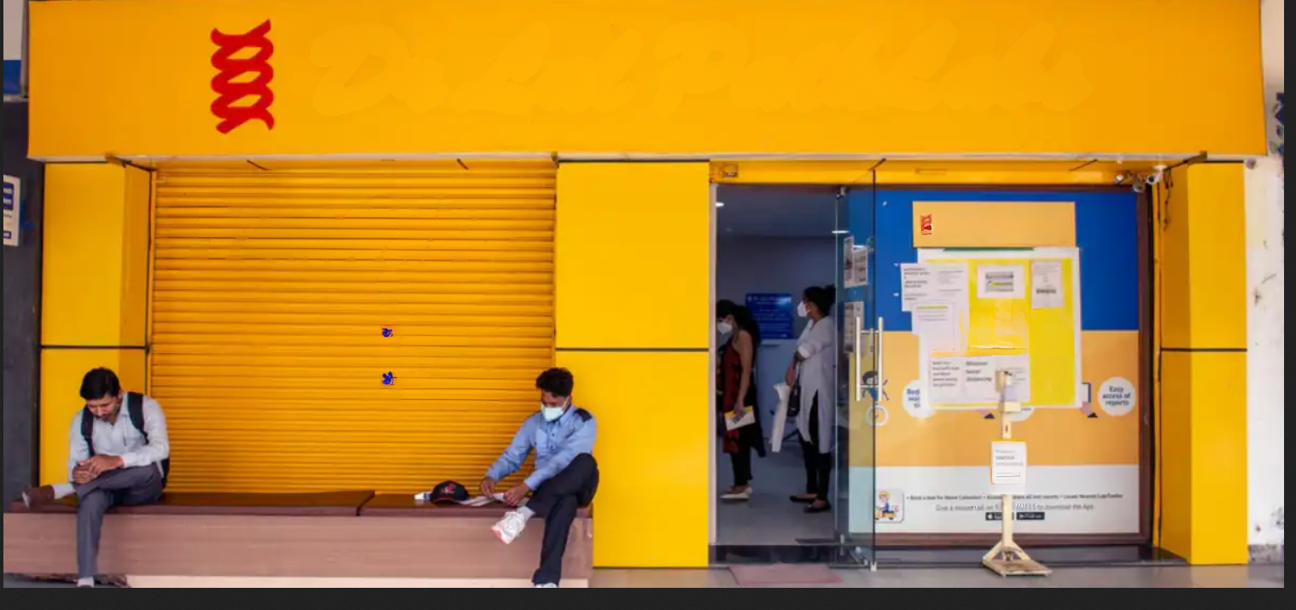

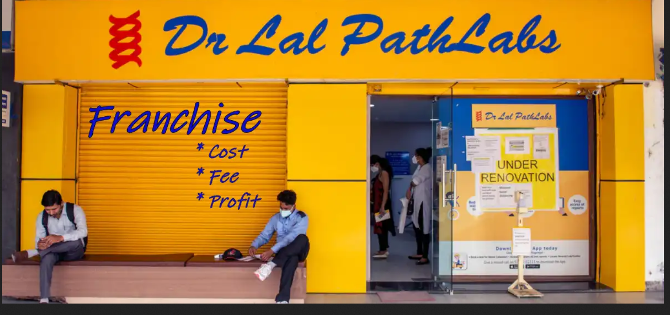
Optimizing Customer Lifecycle Economics in Path lab
BUSINESS DATA MANAGEMENT CAPSTONE PROJECT
Presented by
HARSH SINGH
Roll no. : 22F1001658
1

Slide 2
PROJECT BRIEF
•Objective: Optimize Dr. Lal Path Labs' customer lifecycle economics by reducing acquisition costs, improving profit margins, and enhancing retention rates through data-driven strategies and K-means clustering insights.
•Problem Statement:
I.Reduce the cost of customer acquisition while maintaining or increasing acquisition rates.
II.Improve profit margins through cost optimization and revenue enhancement strategies.
III.Enhance customer retention rates to foster long-term loyalty and profitability.
•Analysis Process/Method
I.Data Collection and Preprocess: Engage with the owner, ensuring privacy, and acquire authenticated 2022 customer data. Utilize Excel for precision trimming, feature engineering (disease addition), and categorical data label encoding.
II. Data Analysis: Tool-powered pattern discernment, analyzing monthly patient/revenue trends, and demographic focus for primary targeting. In-depth customer retention analysis.
III..Customer Clustering: K-means segmentation for tailored marketing, budget optimization, and heightened retention.
Strategize from clustering insights. Implement targeted campaigns for cost-efficient acquisition, improved margins, and enhanced customer retention strategies.
2

Slide 3
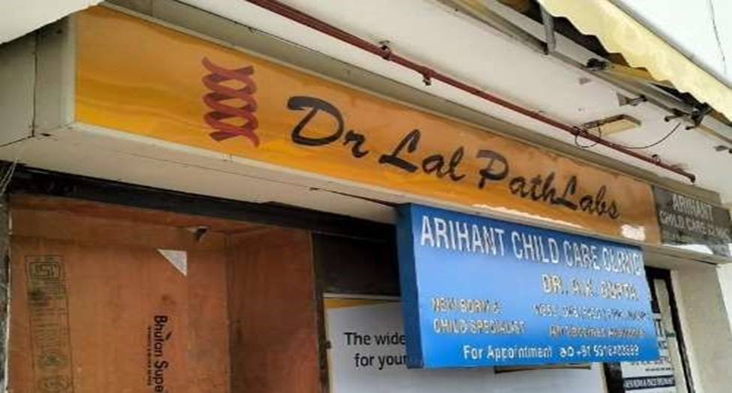
•Name of business: Dr Lal PathLabs centre
•Type of business: Diagnostic pathology services through Lal PathLabs franchise collection centers.
•Location: Prayagraj, Uttar Pradesh
•Services: Comprehensive diagnostic pathology services, including health checkups and home services, offered by Dr Lal PathLabs franchise collection centers.
Owner : Mr. Govind Narayan Singh
ORGANIZATION DETAILS
3

Slide 4
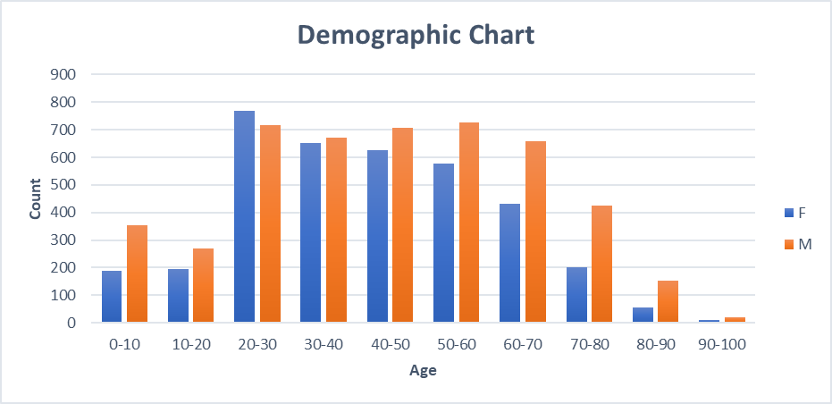
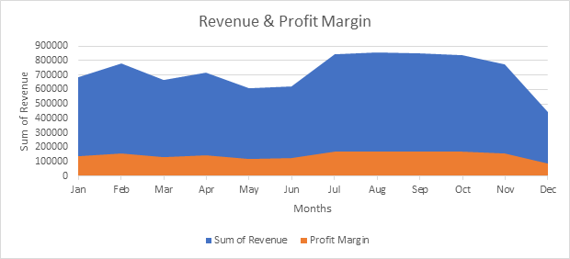
ANALYSIS
Demographic Chart visually captures age distribution and gender disparities, spotlighting concentrations in the 20-30 and 30-40 age groups for nuanced insights.
FIG. 1
Dynamic Area Graph visualizes financial trends, highlighting peaks in July and August, contributing significantly to the annual revenue of 86.83 lakhs, with a robust average profit margin exceeding 20%.
FIG.2
4

Slide 5
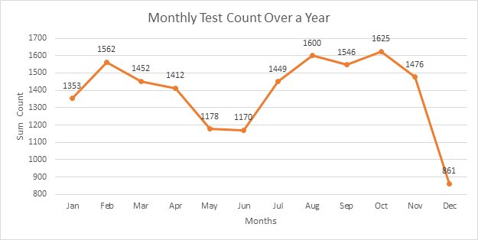
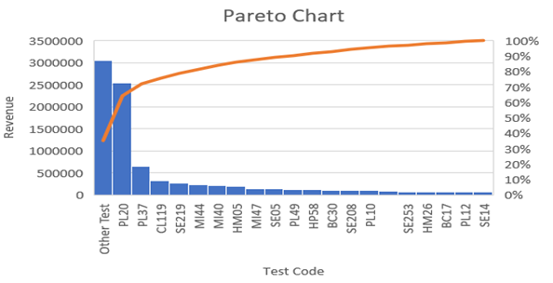
Monthly test graph shows peaks in January and August, likely tied to health checkups, contrasting with December's decline during the holiday season, illustrating seasonality's impact.
FIG. 3
Pareto chart highlights "HEALTHKIND COMPLETE" as the dominant test (29%), guiding strategic resource allocation and service optimization for impactful outcomes.
FIG. 4
5

Slide 6
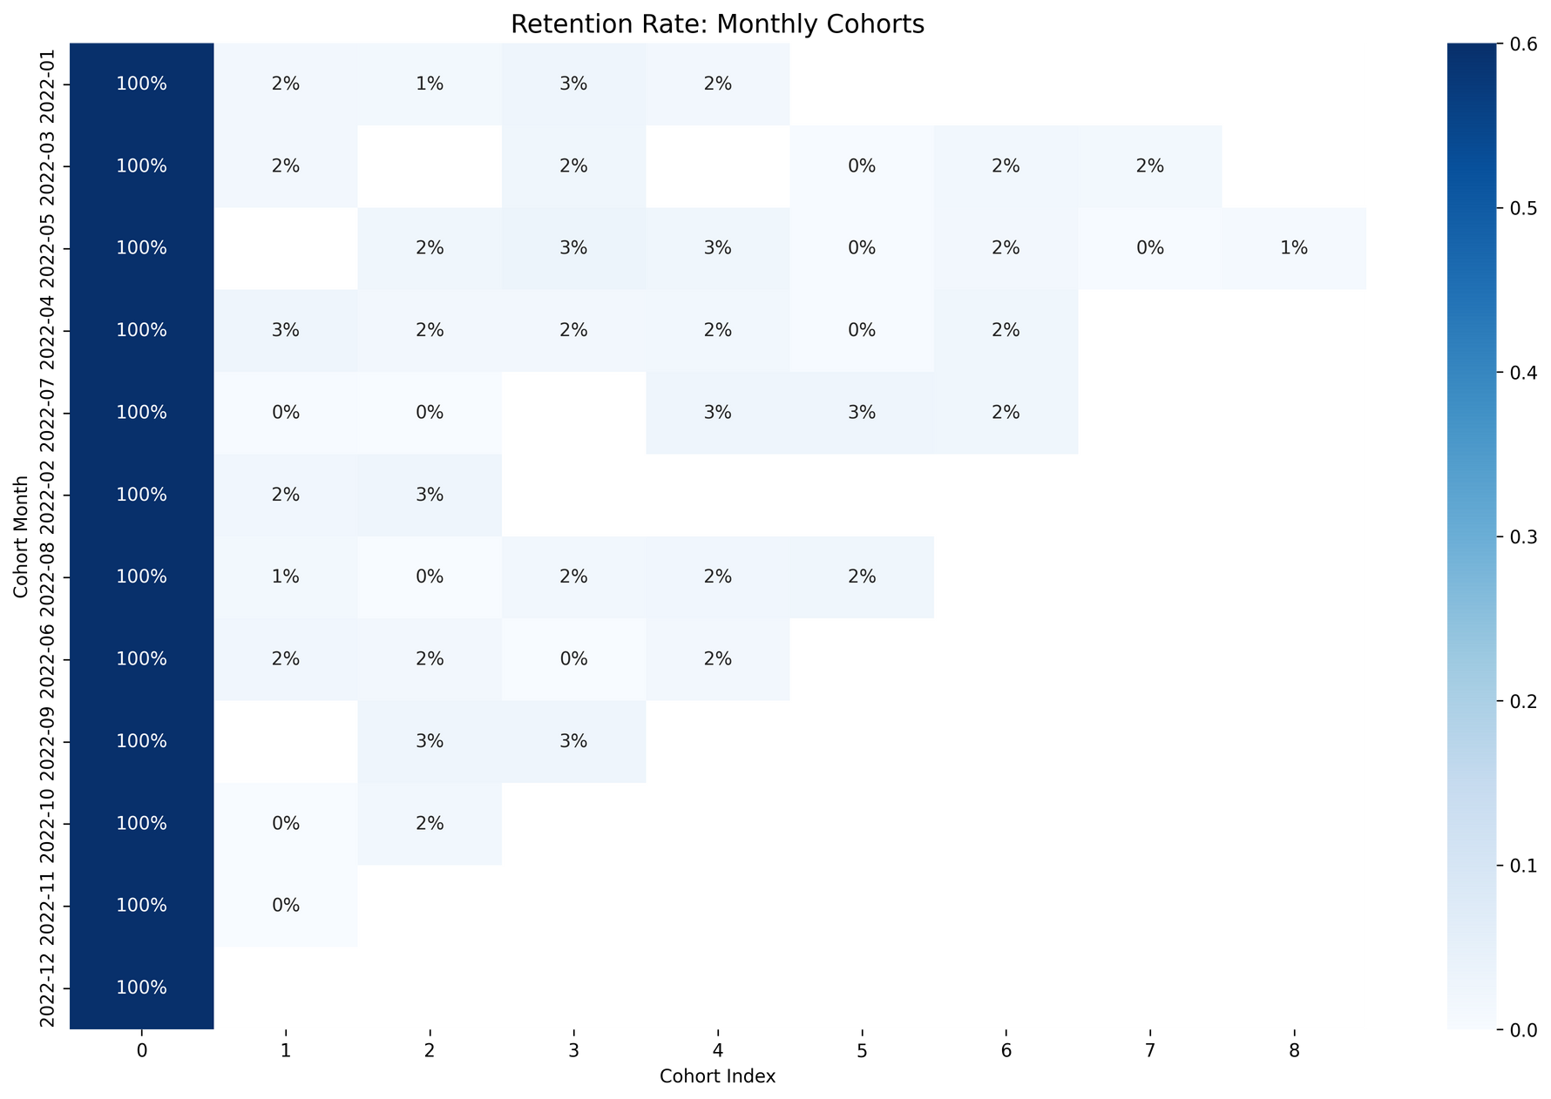
Discover trends in customer retention: January and March cohorts consistently engaged, suggesting targeted strategies for long-term retention, while July and August cohorts require intervention to curb decline, and the June cohort indicates a gradual decrease.
FIG. 5
6

Slide 7
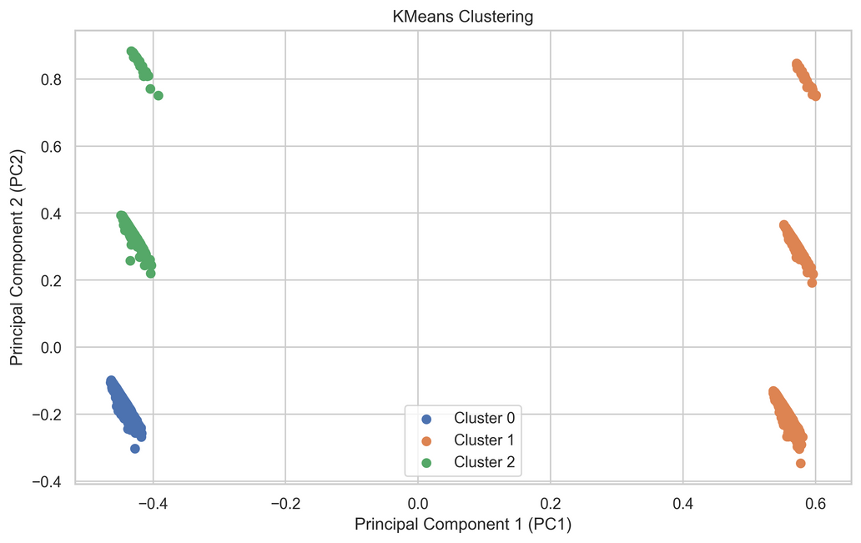
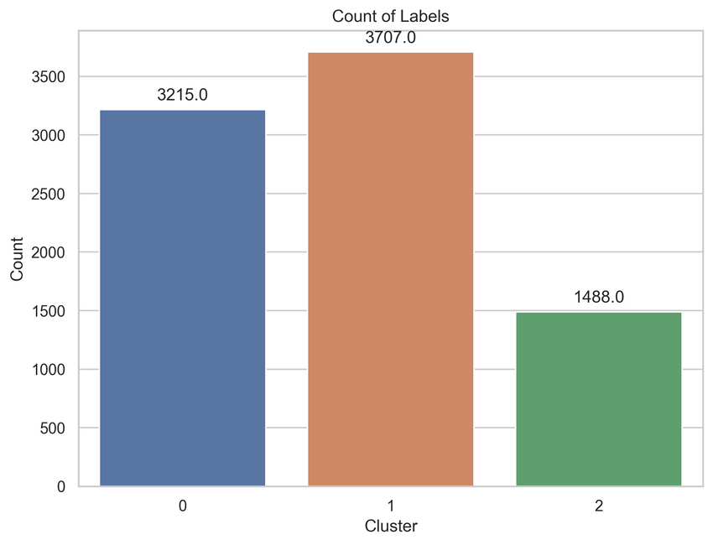
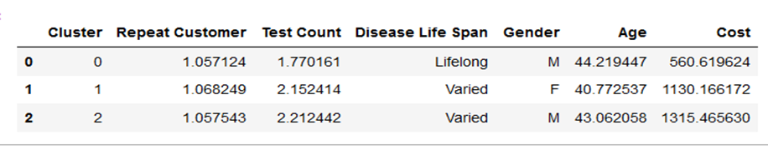
CUSTOMER SEGMENTATION
Based on patients' database, we have used the k-means clustering algorithm to classify them into three distinct clusters.
FIG. 6
The K-means cluster count plot visually represents the segmentation with 3707 instances in Cluster 1, 3215 in Cluster 0, and 1488 in Cluster 2, guiding subsequent analysis.
FIG. 7
K-means reveals three clusters: moderate-cost male, high-cost diverse female, and higher-cost male segments, guiding targeted strategies for enhanced engagement.
FIG. 8
7

Slide 8
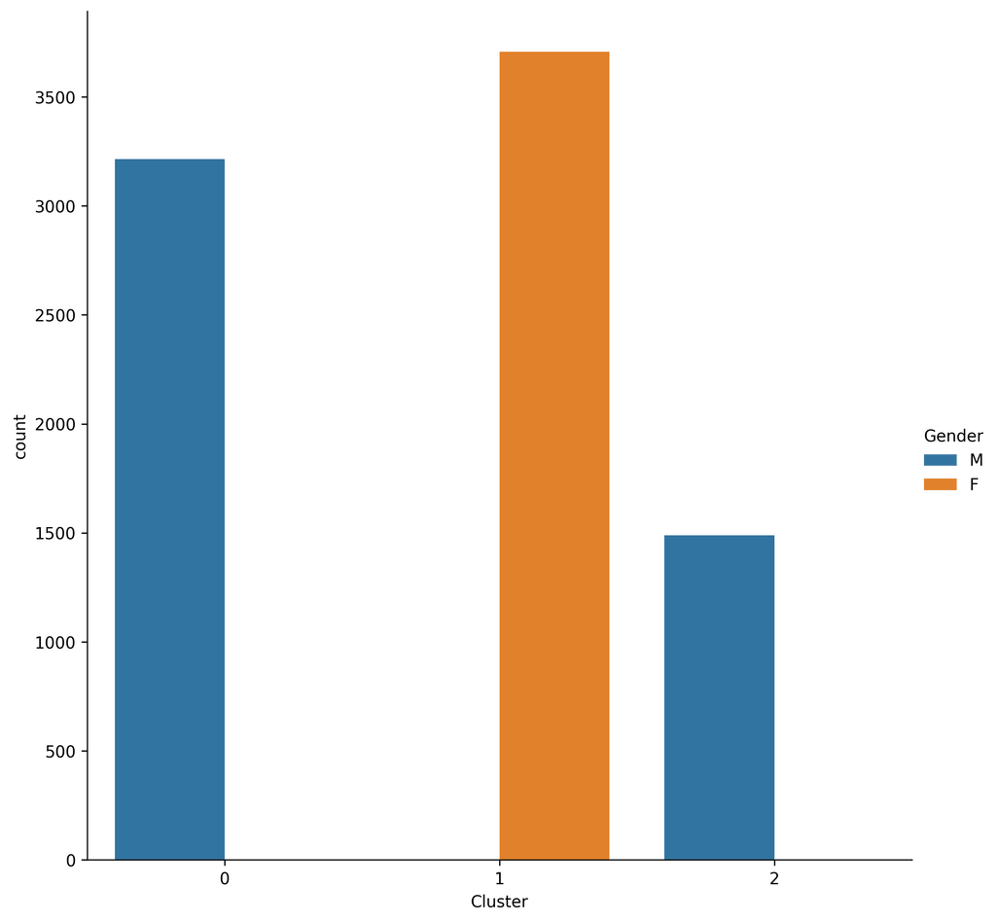
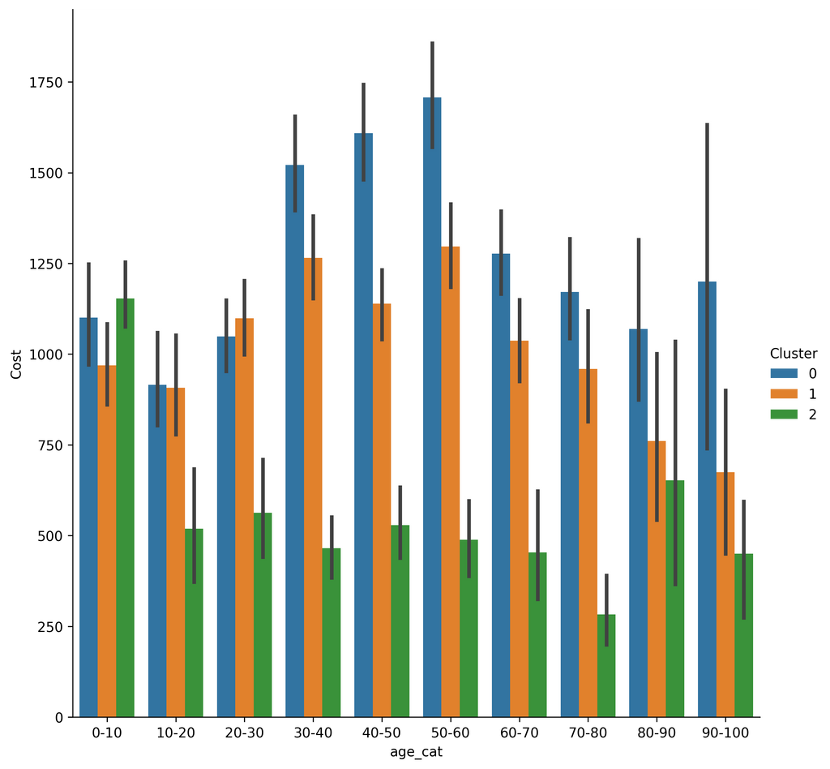
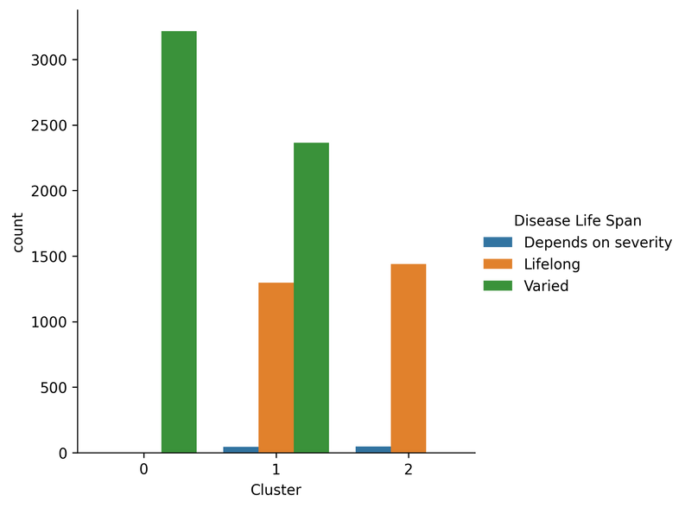
Graph shows Cluster 1 male-centric, Clusters 0 and 2 female-centric, hinting at gender distinctions within clusters.
Triple bar graph depicts Cluster 2 consistently leading in revenue across age groups, emphasizing its dominance in revenue generation.
FIG. 10
Graph suggests Clusters 1 and 2 host varied-life-span diseases, while Cluster 0 features lifelong-life-span conditions, indicating distinct prognostic patterns.
FIG. 9
INTERPRETATION
FIG. 11
8

Slide 9
•Tailor marketing for Cluster 1, focusing on higher-cost female customers. Collaborate with wellness businesses for joint packages and implement personalized loyalty programs.
•Engage Cluster 2 with specialized packages for common male health concerns. Participate in community events and sponsorships to strengthen connections.
•Optimize resource allocation based on high-profit months. Form strategic partnerships for community events, adjusting staffing during low-demand periods.
•Introduce subscription plans for essential tests, promoting loyalty. Collaborate with insurers for bundled packages, ensuring affordability and higher retention rates.
•Explore cost-effective in-house testing for common tests. Invest in modern tech, negotiate bulk procurement, and streamline processes for enhanced customer experience.
Recommendations
9

Slide 10

THANK YOU
10

